Slide 1
Business Process Analysis : Performing a Vehicle Maintenance in a repair Shop
Team 3 : Chinelo Nweke, Denzel Pragassa, Kosala De Silva

Slide 2
Content
As-Is Analysis : EPC of Actual Process
As-Is Analysis : BPMN 2.0 Process Model
Evaluation of Processes & Sub-Processes on basis of KPI
To-Be Process : EPC Model
To-Be Process : BPMN Collaboration Diagram

Slide 3
As-Is Process for Vehicle Maintenance

Slide 4
Actors Involved and Their Activities
Customer: Requesting Maintenance and Approval
Reception: Managing Appointments
Repair Department: Performing Maintenance
Inspection Department: Ensuring Standards and Quality
IT System: Recording feedback and generating diagnosis, quotations.
Accounts Department: Process Payment

Slide 5
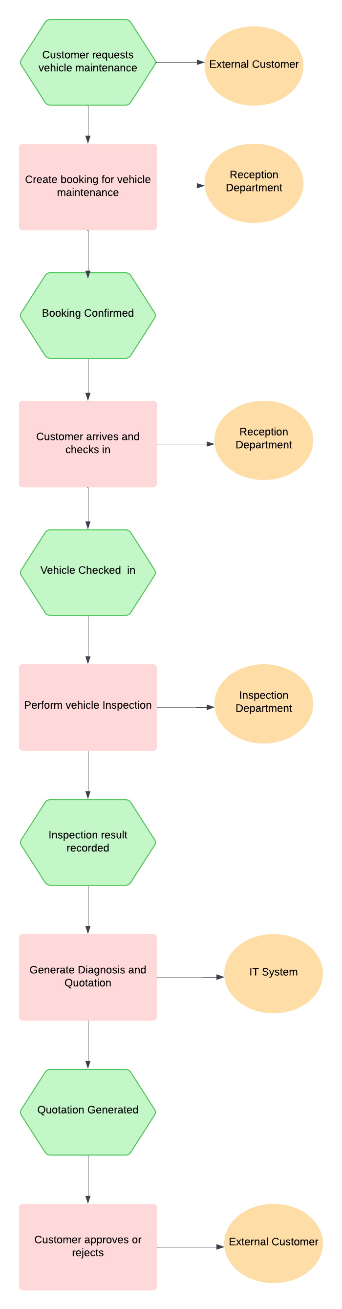
EPC As-Is

Slide 6
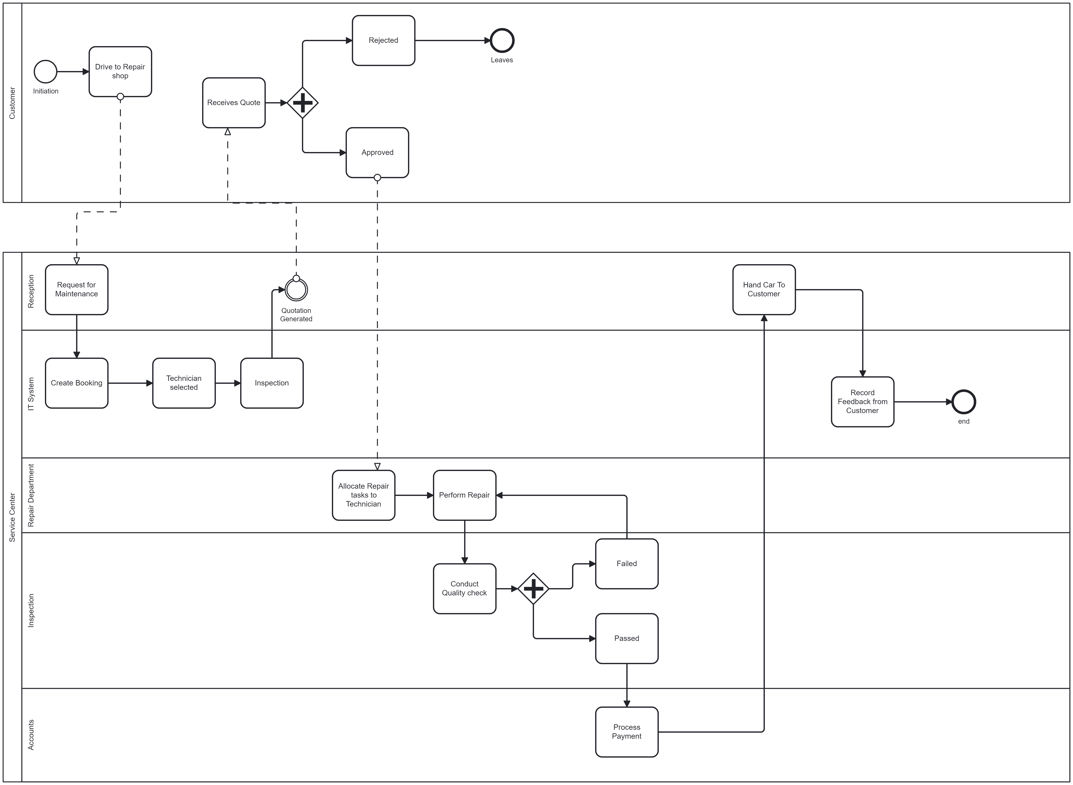
BPMN model for As-IS
Generated on Camunda Modeller

Slide 7
Current Strength and Weaknesses
Strength
Weakness
Customer Involvement: To actively involve ensures transparency
Structured Workflow
IT System Integration
Quality Control
Accountability
Payment Processing
Delays in Time: Due to customer approvals, part availability and in terms of failed quality checks
Limited Automation: Reliance on manual steps
Resource Utilization: Internal and External
Fragmented Communication: Message flows between departments can result in miscommunication or bottleneck processes
Scalability Issues: High volume of Vehicles

Slide 8
Performance and Process Analysis

Slide 9
KPI Overview
The purpose of this evaluation is to assess and improve the vehicle maintenance process for efficiency and customer satisfaction.
Key Performance Indicators (KPIs) are used to measure performance and identify areas needing improvement.
Improving this process is critical for reducing delays, enhancing service quality, and boosting overall customer satisfaction.

Slide 10
KPI for Evaluation
Assessment of Current Process
Strength: Skilled Technicians, well-equipped workshop
Weaknesses: Long wait times, 30% idle technician time, high repetitive maintenance (20%)
Average Service Time: 4 hours/Vehicle
Customer Wait Time: 45 Minutes
Technician Utilization Rate: 70%
First Time Fix Rate: 80%
Customer Satisfaction: 60%

Slide 11
Process Improvement: Proposal
Proposal 1
Appointment Booking System: Customers scheduling maintenance in advance
Proposal 2
Digital Workflow System: Automating task allocation based on skills and availability
Proposal 3
Technician training and quality checks: Regular training and quality control checklists

Slide 12
To-Be Process: Taking Enhanced efficiency and customer satisfaction into consideration

Slide 13
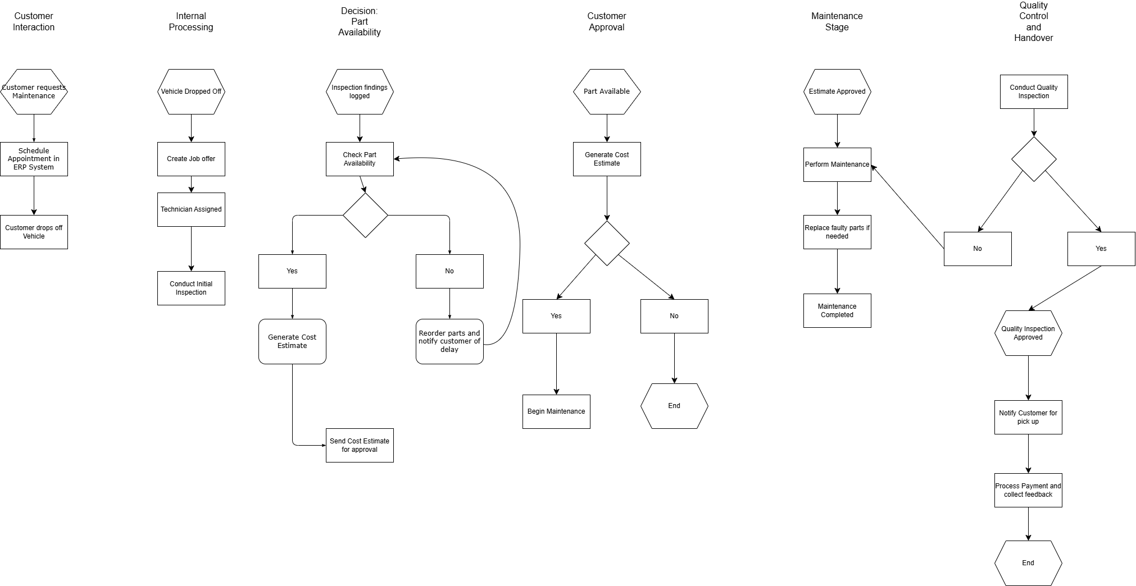
EPC Model: To-Be
Created using Draw.io

Slide 14
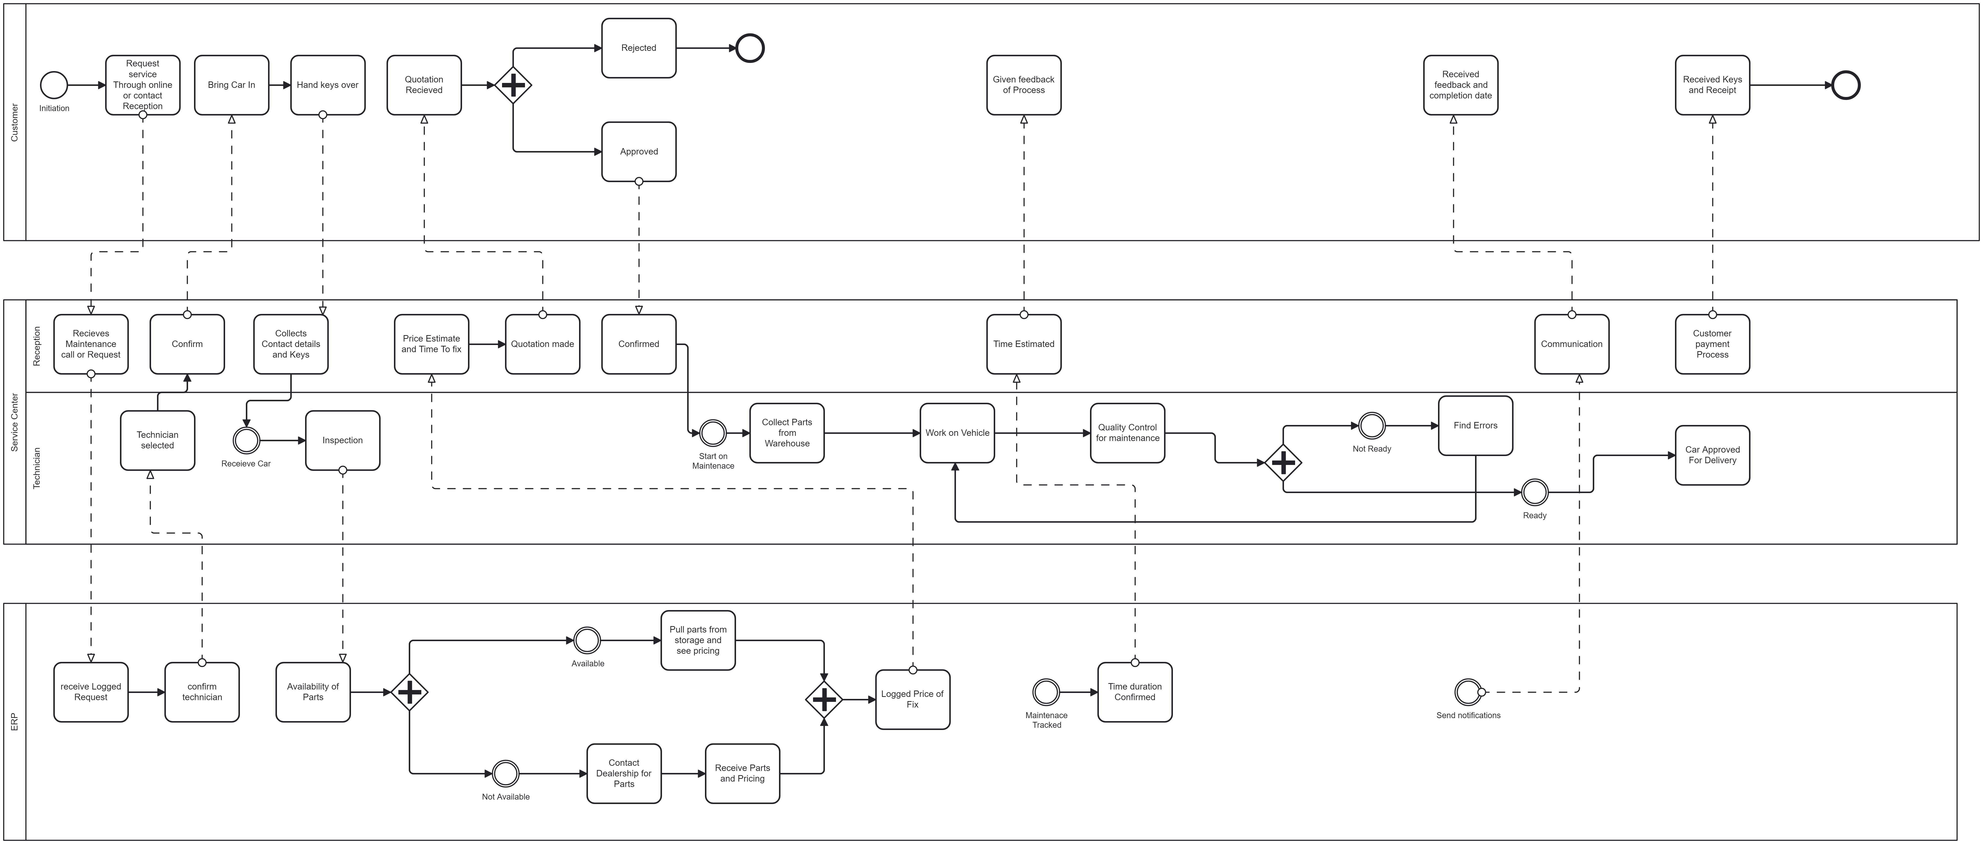
BPMN Process: To-Be
Created Using Camunda Modeler

Slide 15
Q&A Section

Slide 16
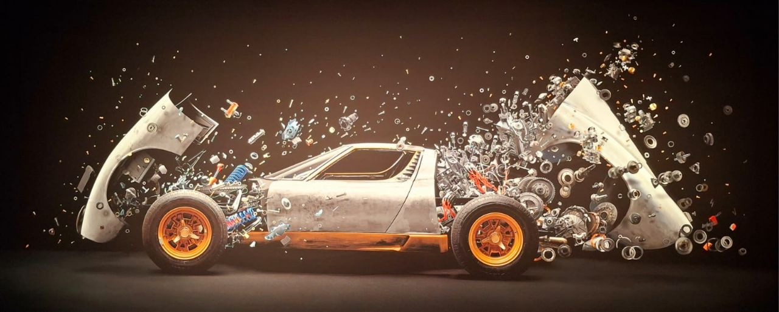
Thank You for your attention

